Slide 1
NoSQL VC SQL.
While building a software application, the question arises where will you store your data and how? The traditional approach is a simple text file or CSV file which is not a good choice in today’s big data world. The solution is Database Management System(DBMS) which allows different user application programs to concurrently access the same Database.
A Database Management system(DBMS) is a simpler, easier, reliable, faster, secure, and powerful software tool for Storing, Managing, and Retrieving data. There are two types of Databases: Relational and Non-Relational Databases. An example of a Relational Database is SQL Server and a Non-Relational Database is MongoDB. We will be discussing the key differences between MongoDB vs SQL Server in this blog

Slide 2
 | SQL Databases | NoSQL Databases
Data Storage Model | Tables with fixed rows and columns | Document: JSON documents, Key-value: key-value pairs, Wide-column: tables with rows and dynamic columns, Graph: nodes and edges
Development History | Developed in the 1970s with a focus on reducing data duplication | Developed in the late 2000s with a focus on scaling and allowing for rapid application change driven by agile and DevOps practices.
Examples | Oracle, MySQL, Microsoft SQL Server, and PostgreSQL | Document: MongoDB and CouchDB, Key-value: Redis and DynamoDB, Wide-column: Cassandra and HBase, Graph: Neo4j and Amazon Neptune
Primary Purpose | General purpose | Document: general purpose, Key-value: large amounts of data with simple lookup queries, Wide-column: large amounts of data with predictable query patterns, Graph: analyzing and traversing relationships between connected data

Slide 3
Schemas | Rigid | Flexible
Scaling | Vertical (scale-up with a larger server) | Horizontal (scale-out across commodity servers)
Multi-Record ACID Transactions | Supported | Most do not support multi-record ACID transactions. However, some — like MongoDB — do.
Joins | Typically required | Typically not required
Data to Object Mapping | Requires ORM (object-relational mapping) | Many do not require ORMs. MongoDB documents map directly to data structures in most popular programming languages.

Slide 4
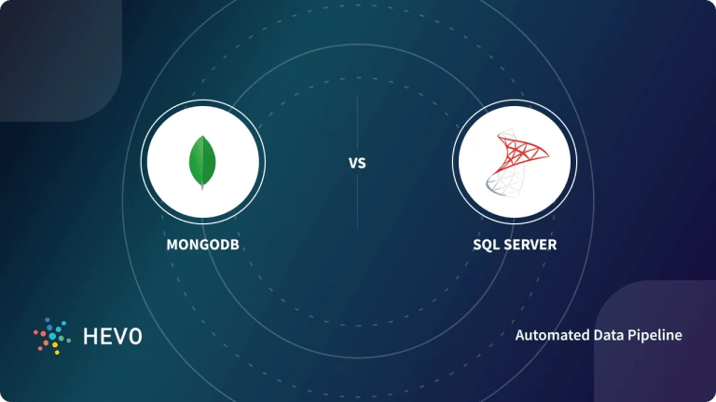

Slide 5
MongoDB: is an open-source, cross-platform, document-oriented, and non-relational database system. MongoDB is developed by MongoDB Inc. and was first released on February 11, 2009. Its stable release is MongoDB 5.0.5 released on 6 December 2021. It is written in different programming languages like JavaScript, Python, Java, PHP, C++, C, Ruby, Perl.
MongoDB is a NoSQL Server in which data is stored in BSON (Binary JSON) documents and each document is essentially built on a key-value pair structure. As MongoDB easily stores schemaless data, make it appropriate for capturing data whose structure is not known. This document-oriented approach is designed to offer a richer experience with modern programming techniques.

Slide 6
* Difference :
Developed by and Initial Release
MongoDB is developed by MongoDB Inc. and was initially released on February 11, 2009.
SQL Server is developed by Microsoft Corporation and was initially released on April 24, 1989.
Database Model
MongoDB is a Non-Relational Database based on a document-oriented structure that internally is based on a key-value structure.
SQL Server is a Relational Database based on relatable structured tables with various rows and columns.
Implementation Language
MongoDB is implemented in JavaScript, Python, Java, PHP, C++, C, Ruby, Perl, C, C++ whereas SQL Server is implemented in C and C++.
License
MongoDB is an Open-Source DBMS whereas a SQL Server license is required for commercial purposes.
Data Schema
MongoDB has a flexible dynamic schema that can easily be changed with the evolution of data, application, or business.
SQL Server has a fixed Schema that is predefined before inserting any data. Fixed schema means schema can’t be changed as data, application, or business requirement evolves.

Slide 7
Query Language
MongoDB uses MongoDB Query Language to query unstructured data from the database.
SQL Server uses SQL Query Language to Create Tables, Insert, Fetch or Update data in the database.
Scalability
MongoDB supports Horizontal Scaling in which data is distributed across clusters. The Sharding process is used to implement horizontal scaling which results in an always-up server.
SQL Server supports vertical scaling which is the traditional approach. In vertical scaling, physical or virtual resources are added to the hosting server of the database.
Map Reduce
MongoDB supports a data processing algorithm for concentrating large volumes of data into aggregated results. MongoDB provides the MapReduce database command to perform map-reduce operations.
SQL Server does not support the Map-Reduce method.
Joins
MongoDB is a non-relational database so it does not support JOINs whereas SQL Server used JOINS to retrieve data from multiple tables which are joined.
Transaction
MongoDB provides multi-document ACID transactions (ACID is an acronym for Atomicity, Consistency, Isolation, Durability) with snapshot isolation, which ensures that the database is in a valid state after a set of database operations is executed.
MS SQL Server also provides ACID transactions with data integrity without snapshot isolation.
XML support
MongoDB doesn’t support XML structured documents. Documents in MongoDB are stored in BSON format.
SQL Server provides support for XML structured data. XML support is integrated into all the components of SQL Server.

Slide 8
Conclusion:
MongoDB is a database that is more advanced and capable of handling big data with dynamic schema features. SQL Server is an RDBMS that is used to manage the relational database system and offers end-to-end business data solutions. In the case of unstructured data MongoDB is a good choice.

